Slide 1
CBC Data Therapy
High-Performance Computing Basics
Xanadu Cluster

Slide 2
Development of models begins at small scale.
Working on your laptop is convenient, simple.
Actual analysis, however is slow.
“Scaling up” typically means a small server or fast multi-core desktop.
Speed exists, but for very large models, not significant.
Single machines don’t scale up forever.
Institute for Systems Genomics:
Computational Biology Core
bioinformatics.uconn.edu

Slide 3
For the larger problems/models, a different approach is required
Institute for Systems Genomics:
Computational Biology Core
bioinformatics.uconn.edu

Slide 4
High-performance computing (HPC)
High-Performance computing involves mainly distinct
computer processors working together on the same
problem/calculation.
Large problem/calculations are divided into smaller parts
and distributed among the many computers.
HPC is a cluster of quasi-independent computers which are
coordinated by a central scheduler.
Institute for Systems Genomics:
Computational Biology Core
bioinformatics.uconn.edu

Slide 5
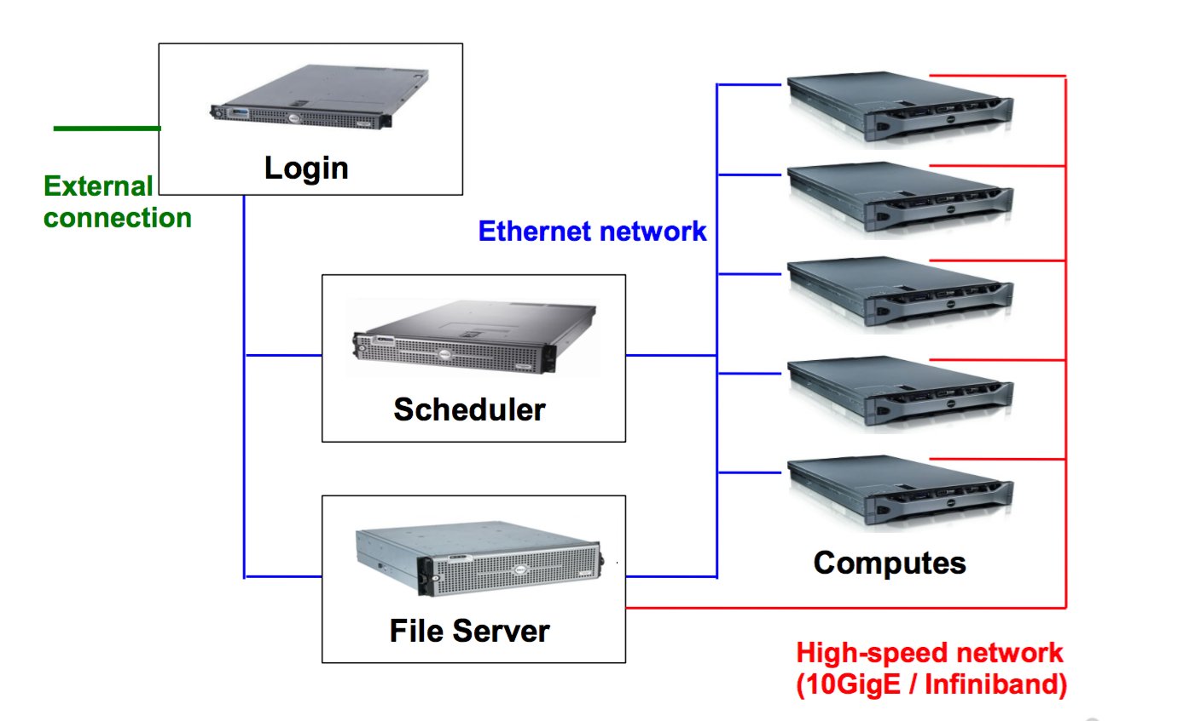
Typical HPC cluster
submit-int
submit-ext
SGE:
Sun Grid Engine
PBS:
Portable Batch System
SLURM:
Simple Linux Utility for
Resource Management
SGE
PBS
SLURM
/$HOME
/linuxshare
Institute for Systems Genomics:
Computational Biology Core
bioinformatics.uconn.edu

Slide 6
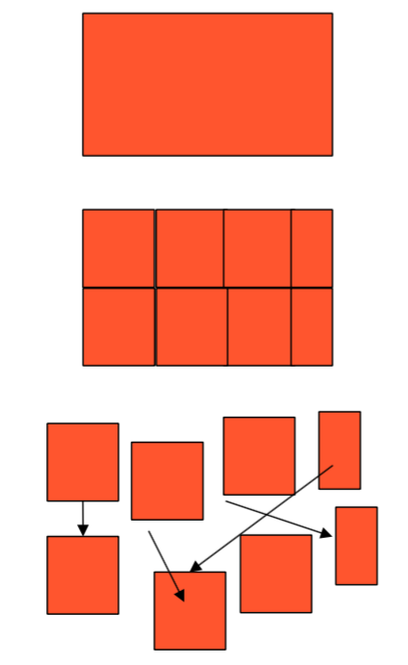
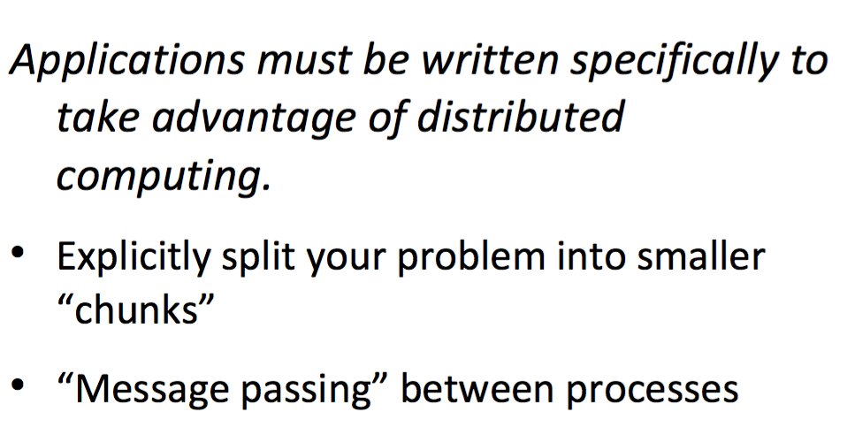
Performance comes at a price: Complexity
Applications must be written specifically to take advantage of distributed computing
Debugging becomes more of challenge
Institute for Systems Genomics:
Computational Biology Core
bioinformatics.uconn.edu

Slide 7
In Summary
• Why HPC
– A huge number of computational and memory requirements
– Cannot be afforded by a PC efficiently
– Speeds and feeds are the keywords
• Who uses High-Performance Computing
– Research institutes, universities and government labs
• Weather and climate research, bioscience, energy, military etc.
– Engineering design: more or less every product we use
• Automotive, aerospace, oil and gas explorations, digital media, financial simulation • Mechanical simulation, package designs, silicon manufacturing etc.
• Similar concepts
– Parallel computing: computing on parallel computers
– Super computing: computing on world 500 fastest supercomputers
Institute for Systems Genomics:
Computational Biology Core
bioinformatics.uconn.edu

Slide 8
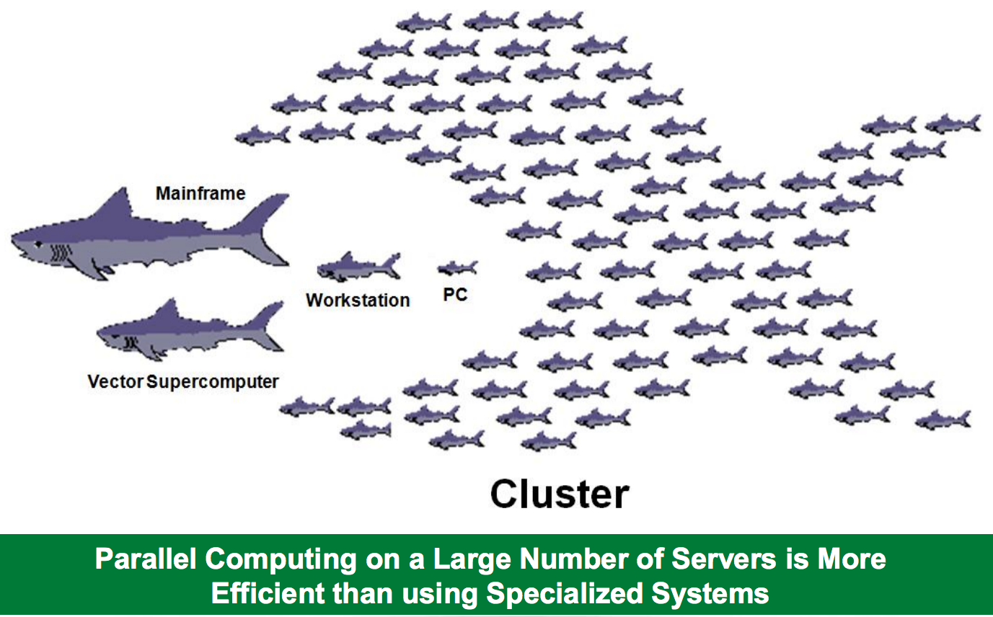
Institute for Systems Genomics:
Computational Biology Core
bioinformatics.uconn.edu

Slide 9
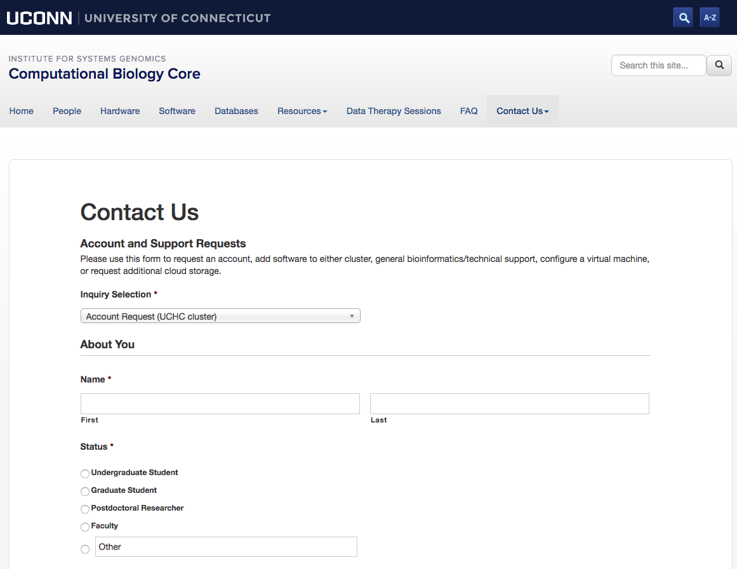
HPC at UCONN
BBC (Storrs): SGE - Research and Teaching
HPC1 (UCH) : PBS - Advanced Research
Xanadu (UCH): SLURM - Advanced research
Institute for Systems Genomics:
Computational Biology Core
bioinformatics.uconn.edu

Slide 10
Connecting to Xanadu
Mac : Terminal : ssh username@xanadu-submit-ext.cam.uchc.edu
Windows : Putty
Open Putty it will open window1.
Provide host name e.g. username@xanadu-submit-ext.cam.uchc.edu
Expand SSH tab and select X11 (shown in window2)
Enable X11 forwarding by selecting it. (window2)
Scroll up the left panel and select Session.(window1)
Name your session e.g. BBC_cluster and click save tab to save.
Your session name should appear in saved sessions.
Double click on your session name to connect to server with SSH session.
Institute for Systems Genomics:
Computational Biology Core
bioinformatics.uconn.edu

Slide 11
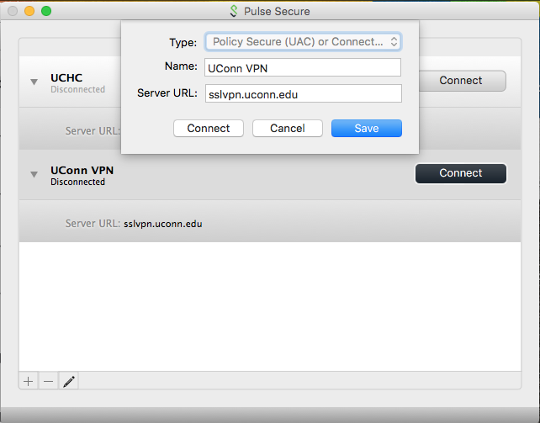
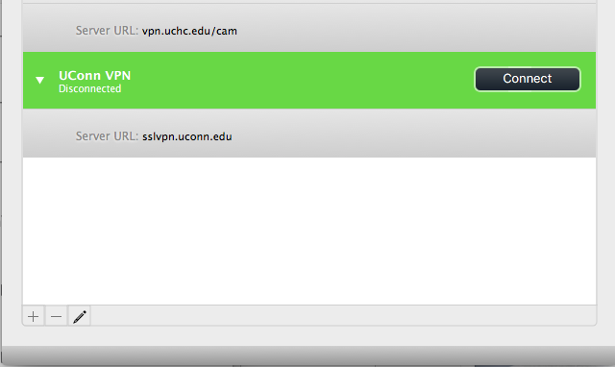
Login: From outside the network (submit-ext node)
Use VPN (Open Pulse secure)
Open Pulse secure
Add new connection
Set Server URL to : sslvpn.uconn.edu
Save
Connect and login with NetID and Passwd
Login: On the submit-int node (Storrs and Outside network)
Open Pulse secure
Add new connection
Set Server URL to : vpn.uchc.edu/cam
Save
Connect and login with CAM ID and Passwd
Institute for Systems Genomics:
Computational Biology Core
bioinformatics.uconn.edu

Slide 12
Connecting to Xanadu
submit-int Node: ssh <user_name>@xanadu-submit-int.cam.uchc.edu
submit-ext Node: ssh <user_name>@xanadu-submit-ext.cam.uchc.edu
Login: (using terminal on mac)
Logged on ext-submit node:
Institute for Systems Genomics:
Computational Biology Core
bioinformatics.uconn.edu

Slide 13
Common Linux commands
pwd : Present Working directory
cd destination : Change directory to destination
cd : Change directory to $HOME
ls : List contents of directory
cp source/file destination/file : Copy file from source in destination folder
mv source/file destination/file : Move file from source to destination folder
mv name name2 : Rename file from name to name2
touch filename : Create an empty file with name filename
mkdir directory : Make directory
rm file : delete file
rm –r directory : delete file with its content
~ : Home directory
cat : Read contents of file
less : Contents of file, scroll, q to quit it
head -10 file : first 10 lines of file
tail -10 file : Bottom 10 lines of file
Resources: http://linuxcommand.org/writing_shell_scripts.php
Institute for Systems Genomics:
Computational Biology Core
bioinformatics.uconn.edu

Slide 14
Common Linux commands to edit file
vi filename : Open file in vim to edit
esc i : Insert or edit file
esc q ! : quit file without saving changes
esc w q ! : Save and quit file
esc dd
Institute for Systems Genomics:
Computational Biology Core
bioinformatics.uconn.edu

Slide 15
Software/tool/packages on cluster
Environment Modules:
The Environment Modules package provides for the dynamic modification
of a user's environment via module files.
module avail : List modules that are available
module load modulefile : Loads the module to user environment
module list : List modules that are loaded
module unload modulefile : unloads module from user environment
module display modulefile : Displays information on module
swap [modulefile1] modulefile2 :Switch loaded modulefile1 with modulefile2.
Institute for Systems Genomics:
Computational Biology Core
bioinformatics.uconn.edu

Slide 16
Xanadu Resources
Partitions
mix
idle
allocated
Institute for Systems Genomics:
Computational Biology Core
bioinformatics.uconn.edu

Slide 17
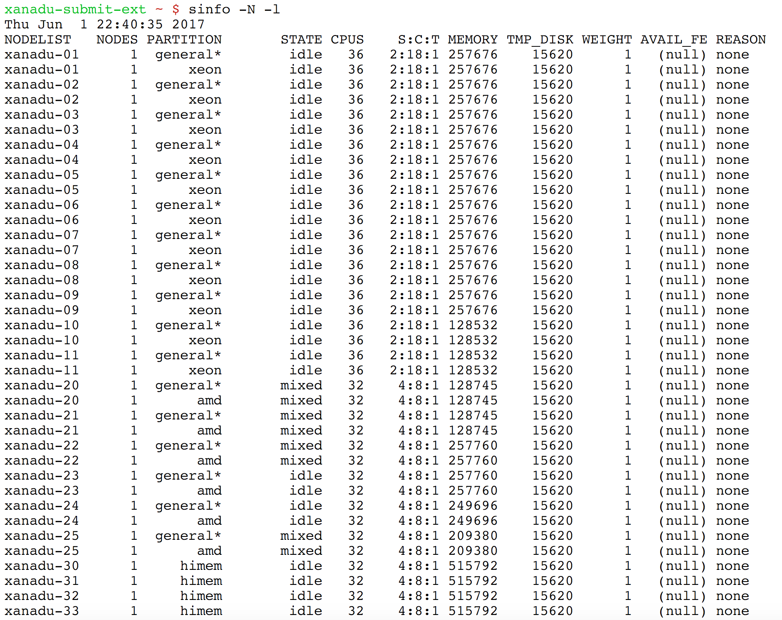
Institute for Systems Genomics:
Computational Biology Core
bioinformatics.uconn.edu

Slide 18
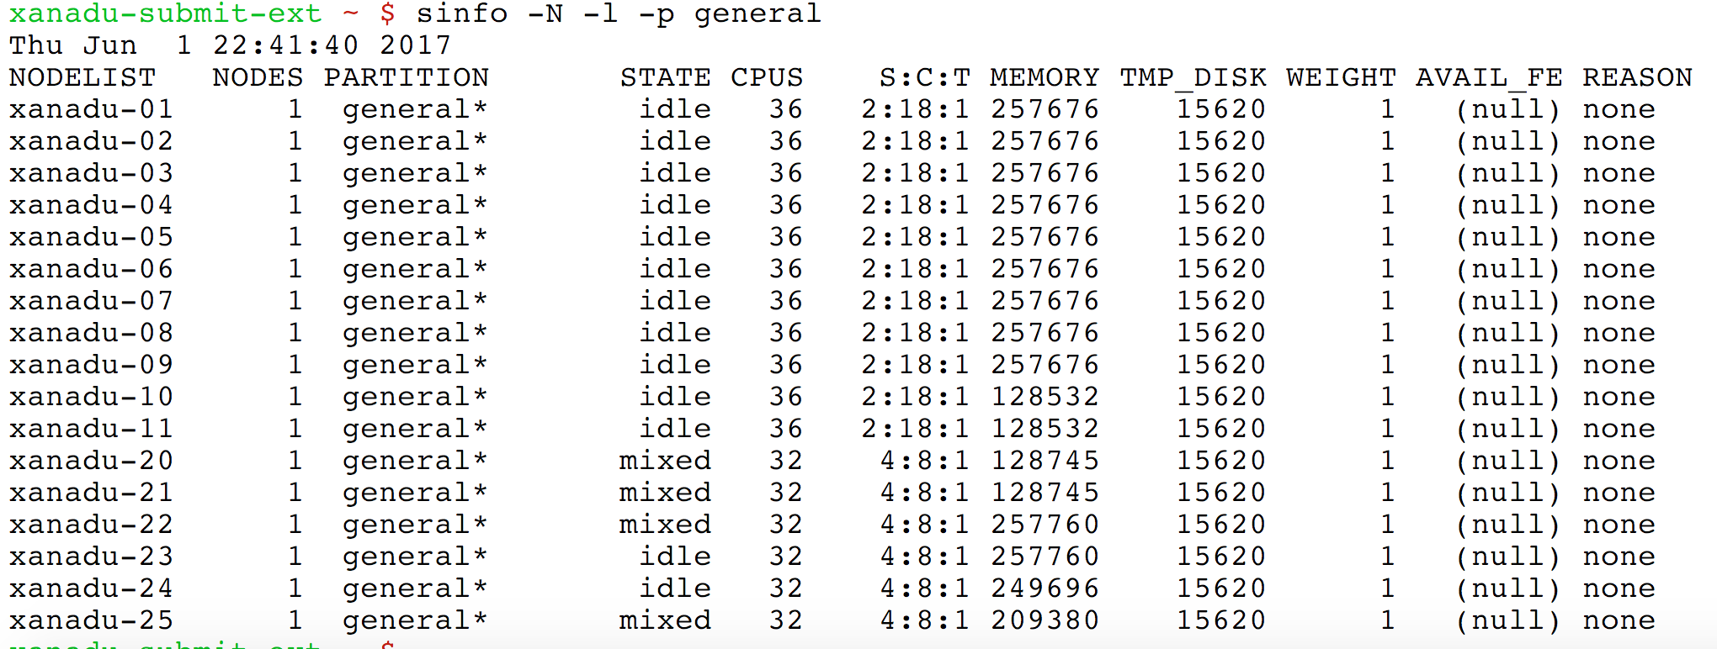
Partition: general
Institute for Systems Genomics:
Computational Biology Core
bioinformatics.uconn.edu

Slide 19
Partition: himem
Institute for Systems Genomics:
Computational Biology Core
bioinformatics.uconn.edu

Slide 20
Summary of the nodes in the Xanadu cluster
Institute for Systems Genomics:
Computational Biology Core
bioinformatics.uconn.edu

Slide 21
Composing a script for cluster
Script:
Resource request
number of CPUs,
computing expected duration,
amounts of RAM or disk space, etc
Job commands
describe tasks that must be done, software which must be run
Institute for Systems Genomics:
Computational Biology Core
bioinformatics.uconn.edu

Slide 22
Resource request:
#SBATCH –j myscript Is the name of your script
#SBATCH -n 1 Request number of cores for your job
#SBATCH -N 1 This line requests that the cores are all on node.
Only change this to >1 if you know your code uses a message
passing protocol like MPI. SLURM makes no assumptions on
this parameter -- if you request more than one core (-n > 1) and
your forget this parameter, your job may be scheduled across nodes
; and unless your job is MPI (multinode) aware, your job will run
slowly, as it is oversubscribed on the master node and wasting
resources on the other(s).
#SBATCH –p general This line specifies the SLURM partition
(in this instance it will be the general partition) under which the script
will be run
#SBATCH --mail-user=first.last@uconn.edu Email which the notification should be sent to
#SBATCH --mail-type=END Mailing options to indicate the state of the
job. In this instance it will send a notification at the end
#SBATCH -o myscript-%j.out Specifies the file to which the standard output will be appended
#SBATCH -e myscript-%j.err Specifies the file to which standard error will be appended
#!/bin/bash
#SBATCH –j myscript
#SBATCH -n 1
#SBATCH -N 1
#SBATCH –p general
#SBATCH --mail-type=END
#SBATCH --mail-user=first.last@uconn.edu
#SBATCH -o myscript-%j.out
#SBATCH -e myscript-%j.err
Institute for Systems Genomics:
Computational Biology Core
bioinformatics.uconn.edu

Slide 23
more on Resource request:
#!/bin/bash
#SBATCH --time=10-01:00:00 # days-hh:mm:ss
#SBATCH --job-name=masurca_KG
#SBATCH --mail-user=user@uconn.edu
#SBATCH --mail-type=ALL
#SBATCH --comment=dataset_wuith_jump_libraries
#SBATCH –N 1
#SBATCH –n 8
#SBATCH --mem-per-cpu=10240 # 10GB
or #SBATCH –mem=100G
#SBATCH -o filterGTF-%j.output
#SBATCH -e filterGTF-%j.error
Institute for Systems Genomics:
Computational Biology Core
bioinformatics.uconn.edu

Slide 24
Job commands:
They are regular linux/module commands
echo "Hello World"
Final script:
#!/bin/bash
#SBATCH --job-name=myscript
#SBATCH -n 1
#SBATCH -N 1
#SBATCH --partition=general
#SBATCH --mail-type=END
#SBATCH --mail-user=first.last@uconn.edu
#SBATCH -o myscript-%j.out
#SBATCH -e myscript-%j.err
echo "Hello World"
save the script as myscript.sh
Institute for Systems Genomics:
Computational Biology Core
bioinformatics.uconn.edu

Slide 25
Submit the script:
sbatch
$ sbatch myscript.sh
Monitor Job:
squeue
$ squeue
JOBID PARTITION NAME USER ST TIME NODES NODELIST(REASON) 246233 general STO_001_ dtrujill CG 4:48 1 xanadu-21 225302 general file18 etulman CG 22-11:03:24 1 xanadu-21 297908 himem masurca_ hralicki PD 0:00 1 (Resources) 301086 himem ProtMasN vsingh PD 0:00 1 (Priority) 301089 himem ProtMasW vsingh PD 0:00 1 (Priority) 301013 amd ProtMasN vsingh R 21:44:59 1 xanadu-24 301008 amd ProtMasW vsingh R 21:46:47 1 xanadu-20 297400 himem bfo_111 dtrujill R 1-23:18:04 4 xanadu-[30-33] 203251 general blastp cfisher R 9-05:35:43 1 xanadu-23 203252 general blastp cfisher R 9-05:35:43 1 xanadu-23
Institute for Systems Genomics:
Computational Biology Core
bioinformatics.uconn.edu

Slide 26
squeue –j jobIDNUMBER
$ clear$ squeue -j 301013
JOBID PARTITION NAME USER ST TIME NODES NODELIST(REASON)
301013 amd ProtMasN vsingh R 21:49:06 1 xanadu-24
JOB STATE CODES
Jobs typically pass through several states in the course of their execution. The typical states are PENDING, RUNNING,SUSPENDED, COMPLETING, and COMPLETED. An explanation of each state follows.
CA CANCELLED Job was explicitly cancelled by the user or system administrator. The job may or may not have been initiated.
CD COMPLETED Job has terminated all processes on all nodes with an exit code of zero. CF CONFIGURING Job has been allocated resources,become readyfor use (e.g. booting).
CG COMPLETING
F FAILED Job terminated with non-zero exit code or other failure condition.
NF NODE_FAIL Job terminated due to failure of one or more allocated nodes.
PD PENDING Job is awaiting resource allocation.
PR PREEMPTED Job terminated due to preemption.
R RUNNING Job currently has an allocation.
ST STOPPED Job has an allocation, but execution has been stopped with SIGSTOP signal. CPUS have been retained by this job.
S SUSPENDED Job has an allocation, but execution has been suspended and CPUs have been released for other jobs.
TO TIMEOUT Job terminated upon reaching its time limit.
Institute for Systems Genomics:
Computational Biology Core
bioinformatics.uconn.edu

Slide 27
squeue –u userID
$squeue -u vsingh
JOBID PARTITION NAME USER ST TIME NODES NODELIST(REASON)
301086 himem ProtMasN vsingh PD 0:00 1 (Priority)
301089 himem ProtMasW vsingh PD 0:00 1 (Priority)
301013 amd ProtMasN vsingh R 22:00:08 1 xanadu-24
301008 amd ProtMasW vsingh R 22:01:56 1 xanadu-20
squeue –u userID –t PENDING
squeue –u userID –t RUNNING
$ squeue -u vsingh -t PENDING
JOBID PARTITION NAME USER ST TIME NODES NODELIST(REASON) 301086 himem ProtMasN vsingh PD 0:00 1 (Priority) 301089 himem ProtMasW vsingh PD 0:00 1 (Priority)
Institute for Systems Genomics:
Computational Biology Core
bioinformatics.uconn.edu

Slide 28
scontrol show jobid <jobid>
scontrol show jobid –dd <jobid>
$ scontrol show jobid 301086
JobId=301086 JobName=ProtMasNoSOAP
UserId=vsingh(183147) GroupId=domain users(10000) MCS_label=N/A
Priority=5262 Nice=0 Account=pi-wegrzyn QOS=general
JobState=PENDING Reason=Priority Dependency=(null)
Requeue=1 Restarts=0 BatchFlag=1 Reboot=0 ExitCode=0:0
RunTime=00:00:00 TimeLimit=UNLIMITED TimeMin=N/A SubmitTime=2017-06-28T15:50:23 EligibleTime=2017-06-28T15:50:23 StartTime=2018-06-27T14:06:17 EndTime=Unknown Deadline=N/A
PreemptTime=None SuspendTime=None SecsPreSuspend=0
Partition=himem AllocNode:Sid=xanadu-submit-ext:32674
ReqNodeList=(null) ExcNodeList=(null)
NodeList=(null)
NumNodes=1-1 NumCPUs=30 NumTasks=30 CPUs/Task=1 ReqB:S:C:T=0:0:*:* TRES=cpu=30,mem=512000,node=1 Socks/Node=* NtasksPerN:B:S:C=0:0:*:1 CoreSpec=* MinCPUsNode=1 MinMemoryNode=500G MinTmpDiskNode=0 Features=(null) Gres=(null) Reservation=(null) OverSubscribe=OK Contiguous=0 Licenses=(null) Network=(null) Command=/home/CAM/vsingh/protea_repens/scripts/assemble_protea_config_noSOAPassembly.sh WorkDir=/home/CAM/vsingh/protea_repens/scripts StdErr=/home/CAM/vsingh/protea_repens/LogFiles/ProtMasNoSOAP-301086.error StdIn=/dev/null StdOut=/home/CAM/vsingh/protea_repens/LogFiles/ProtMasNoSOAP-301086.output Power=
Institute for Systems Genomics:
Computational Biology Core
bioinformatics.uconn.edu

Slide 29
Script submission and other commands
sbatch myscript.sh : Sumit script for execution
squeue : Status of Jobs currently running on cluster (all users)
squeue –j jobIDNUMBER : Status of job with jobIDNumber
squeue -u UserID : Status of all the jobs submitted by user
scancel jobID_number : Delete job with jobID_number
scancel <jobid> <index> : Delete an array job
scancel –u UserID : Delete all the jobs of a user
Institute for Systems Genomics:
Computational Biology Core
bioinformatics.uconn.edu

Slide 30
Script for Array jobs
#!/bin/bash
#SBATCH –mail-user=user@uconn.edu
#SBATCH --mail-type=ALL
#SBATCH --ntasks=1
#SBATCH --mem=1G
#SBATCH --array=1-1002%100
#SBATCH --output=fastqc_%A_%a.out
This line will create 1002 jobs, but it instructs slurm to limit the total number of simultaneously running jobs to 100. This avoids swamping the queue, and shares bursting level with others in the group
This will create 1002 files to catch stdin, stdout and stderr for each respective job in the array. If the array job ID is 23678, we will fine 1002 files starting with fastqc_23678_1.out … fastqc_23678_1002.out
cd /NGSseq/data
module load fastqc/0.11.5
echo "SLURM_JOBID: " $SLURM_JOBID
echo "SLURM_ARRAY_TASK_ID: " $SLURM_ARRAY_TASK_ID
echo "SLURM_ARRAY_JOB_ID: " $SLURM_ARRAY_JOB_ID
arrayfile=`ls | awk -v line=$SLURM_ARRAY_TASK_ID '{if (NR == line) print $0}'`
fastqc $arrayfile
Start: Slurm job ID and increase with each array job
Slurm job ID
Array job ID : 1-1002
This will list all the files from the directory (/NGSseq/data)
and then pick up one file at a time andthen run it through fastqc application.
Institute for Systems Genomics:
Computational Biology Core
bioinformatics.uconn.edu

Slide 31
Typical HPC cluster
submit-int
submit-ext
SGE:
Sun Grid Engine
PBS:
Portable Batch System
SLURM:
Simple Linux Utility for
Resource Management
SGE
PBS
SLURM
/$HOME
/linuxshare
Institute for Systems Genomics:
Computational Biology Core
bioinformatics.uconn.edu

Slide 32
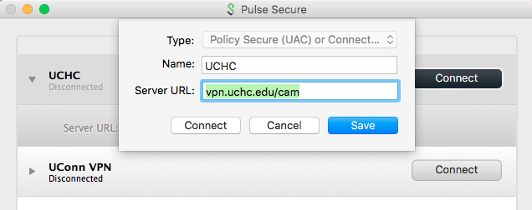
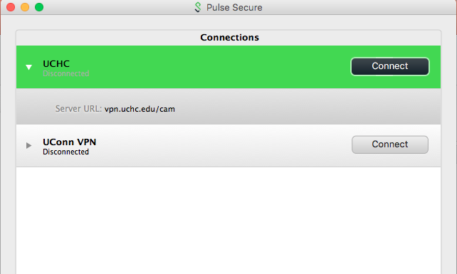
Interactive Sessions (only on submit-int nodes)
Login: On the submit-int node (Storrs and Outside network)
Open Pulse secure
Add new connection
Set Server URL to : vpn.uchc.edu/cam
Save
Connect and login with CAM ID and Passwd
Institute for Systems Genomics:
Computational Biology Core
bioinformatics.uconn.edu

Slide 33
submit-int Node:
ssh <user_name>@xanadu-submit-int.cam.uchc.edu
ssh vsingh@xanadu-submit-int.cam.uchc.edu
vsingh@xanadu-submit-int.cam.uchc.edu's password:
X11 forwarding request failed on channel 0
Last login: Wed Jun 28 12:59:06 2017 from 10.86.10.229
$
$ srun --pty bash
xanadu-22 ~ $
Institute for Systems Genomics:
Computational Biology Core
bioinformatics.uconn.edu

Slide 34
Some important Informations:
BBC | Xanadu
/tempdata3 | /home/CAM/username or /home/FCAM/username
/archive | /linuxshare/userfolder
Database Info
Database directory | /isg/shared/databases
AlignerIndex (Genome/Transcriptome) | /isg/shared/databases/AlignerIndex/animal /isg/shared/databases/AlignerIndex/microbial /isg/shared/databases/AlignerIndex/archea /isg/shared/databases/AlignerIndex/plant
Blast Index | /isg/shared/databases/Blast
Institute for Systems Genomics:
Computational Biology Core
bioinformatics.uconn.edu

Slide 35
Thank you
Institute for Systems Genomics:
Computational Biology Core
bioinformatics.uconn.edu

